Slide 1
Capstone final assignment presentation

Slide 2
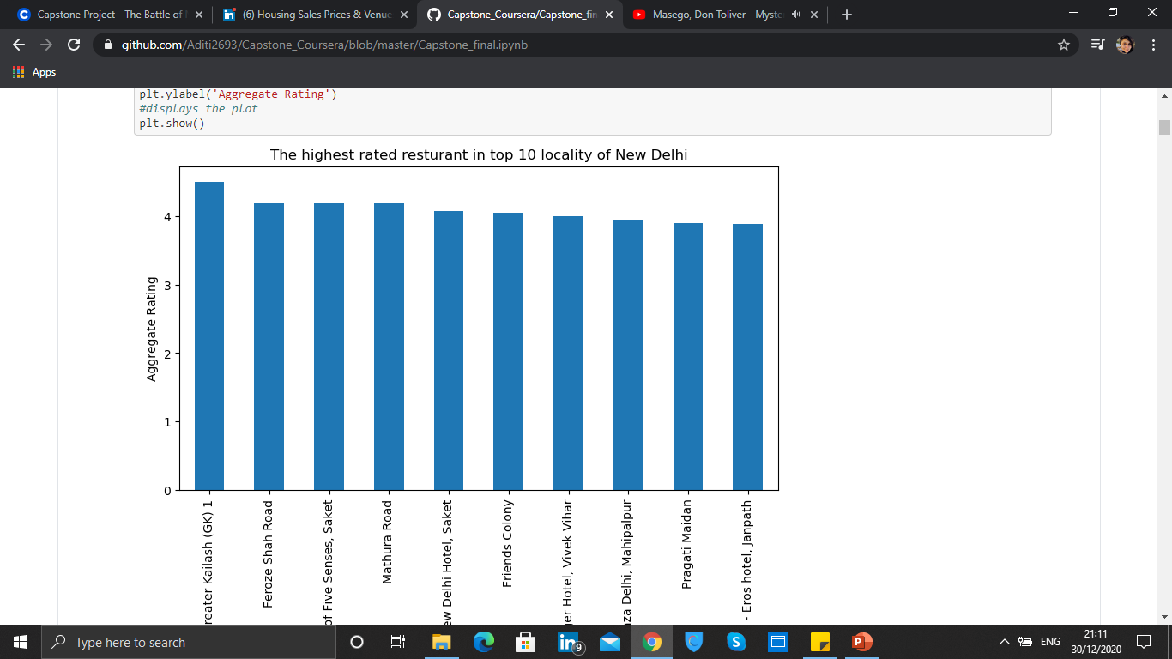
Top 10 locality with highest rated restaurants

Slide 3
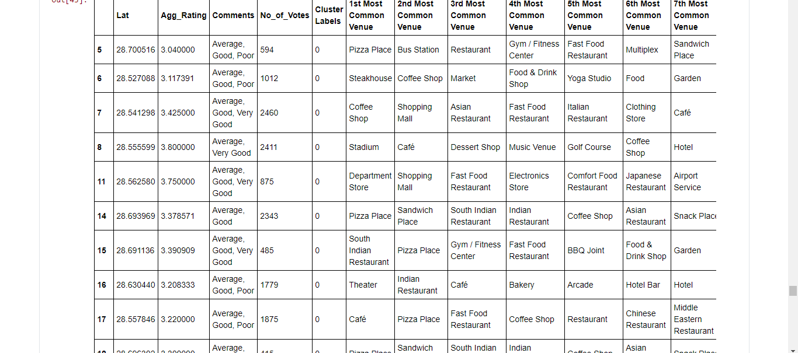
Most common place visited was Pizza Place

Slide 4
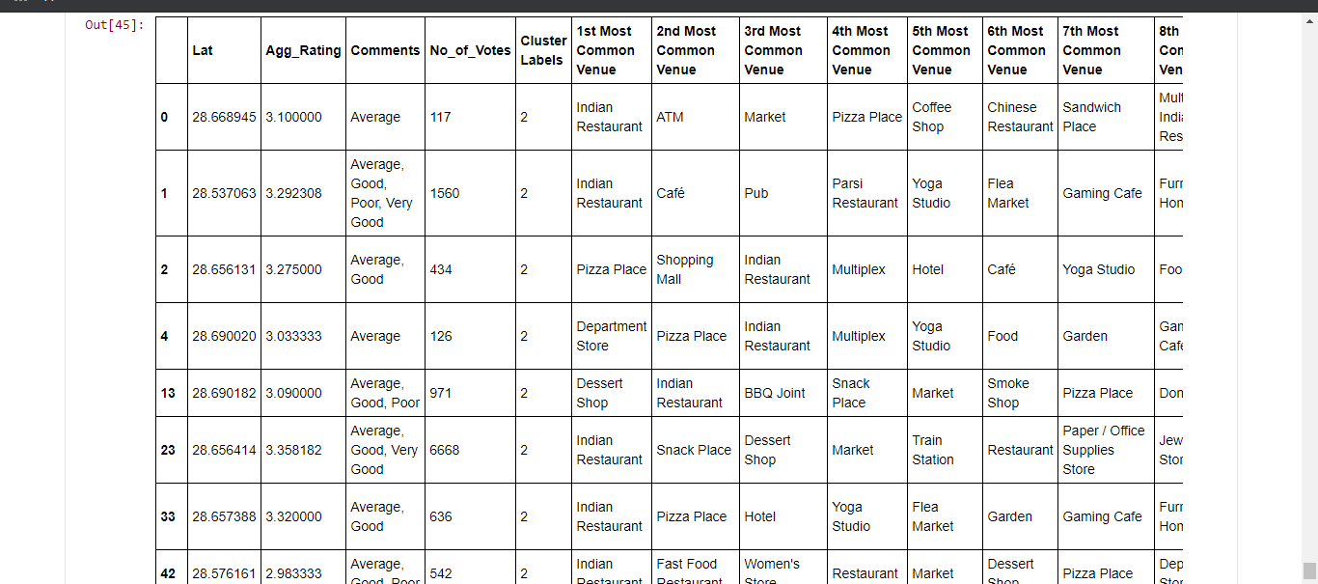
Most rating received by was Indian restaurant

Slide 5
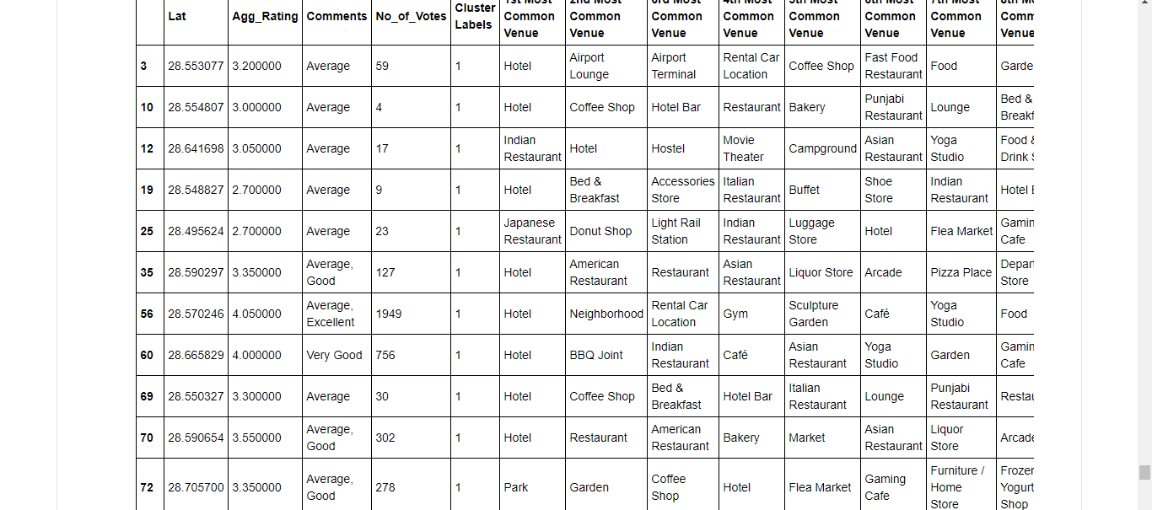
Most number of votes were received by Hotels

